Slide 1
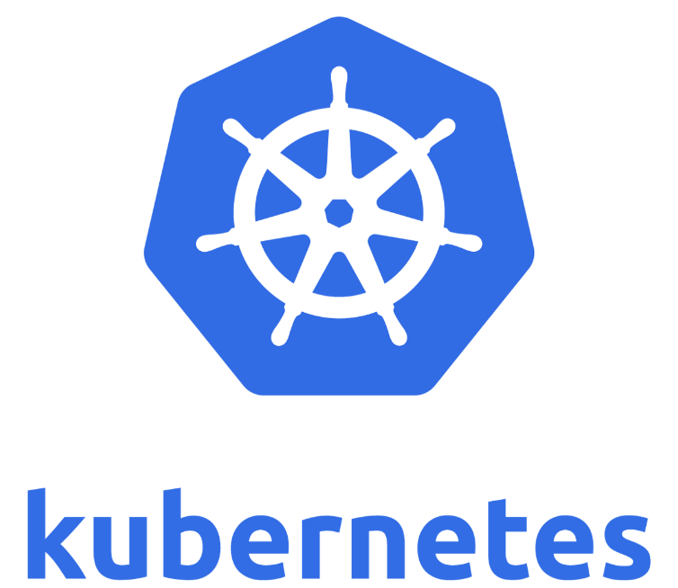
Labs on Kubernetes
Vaibhav
Cloud COE Team

Slide 2

Name: Vaibhav Gupta
Designation: Consultant Architect
Team: Cloud COE
Experience (Yrs): 12.5
Expertise: Docker | K8s | Cloud | Devops | Microservices | Server less | Migration | Presales | Consulting
LinkedIn: www.linkedin.com/in/vg-cloud-world
Github: https://github.com/VaibhavG10
Dockerhub: https://cloud.docker.com/u/vaibhav2016

Slide 3
Agenda
Introduction
Lab 1: HelloWorld with POD, Replicaset & Deployment
Lab 2: Daemonset & Namespace
Lab 3: Service & Nodeport
Lab 4: Work with Commands
Q n A
Next Steps

Slide 4
Introduction
About Container Orchestration
Kubernetes
Why Kubernetes?
Different Container Orchestration Tool
Comparison (k8s – Swarm – Mesos – ECS)
Kubernetes Components – Master
Kubernetes Components - Slave

Slide 5
About Container Orchestration
Container Orchestration is a tool that automates the deployment, management, scaling, networking, and availability of container-based applications.
Container orchestration is all about managing the lifecycles of containers
Provisioning and deployment of containers
Scaling up or removing containers to spread application load
Allocation of resources between containers
Load balancing of service discovery between containers
Health monitoring of containers and hosts
Redundancy and availability of containers
Configuration of an application in relation to the containers running it

Slide 6
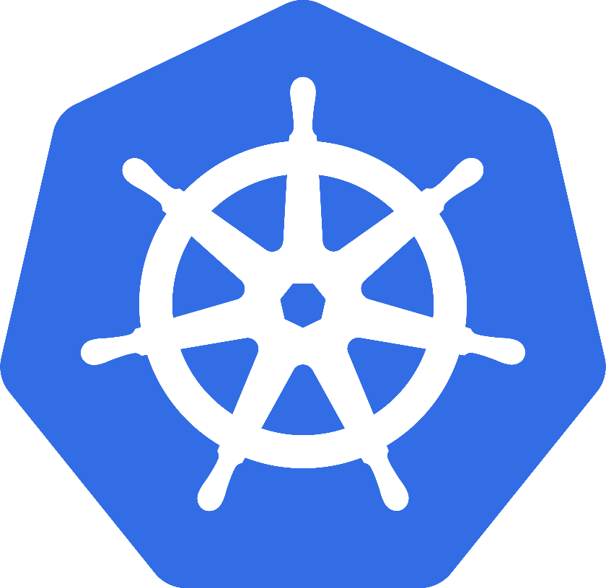
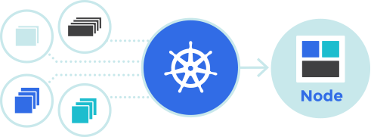
Kubernetes
Kubernetes is an open source container orchestration platform for automating deployment, scaling, and management of containerized applications

Slide 7
WhY Kubernetes?
Largest community among container orchestration tools. Over 50,000 commits and 1200 contributors
Google used to manage containers from last 10 years. So, huge applications experience and mature model for productions.
Wide variety of storage options, including on-premises SANs & public clouds.
It supports other container platforms apart from docker like RKT.
Kubernetes is open source project, its distinct from other “vendor-driven” project like Swarm, Mesos, CloudFoundry, AWS ECS. Docker Swarm is also open source but it offers a simple solution compare to k8s.

Slide 8
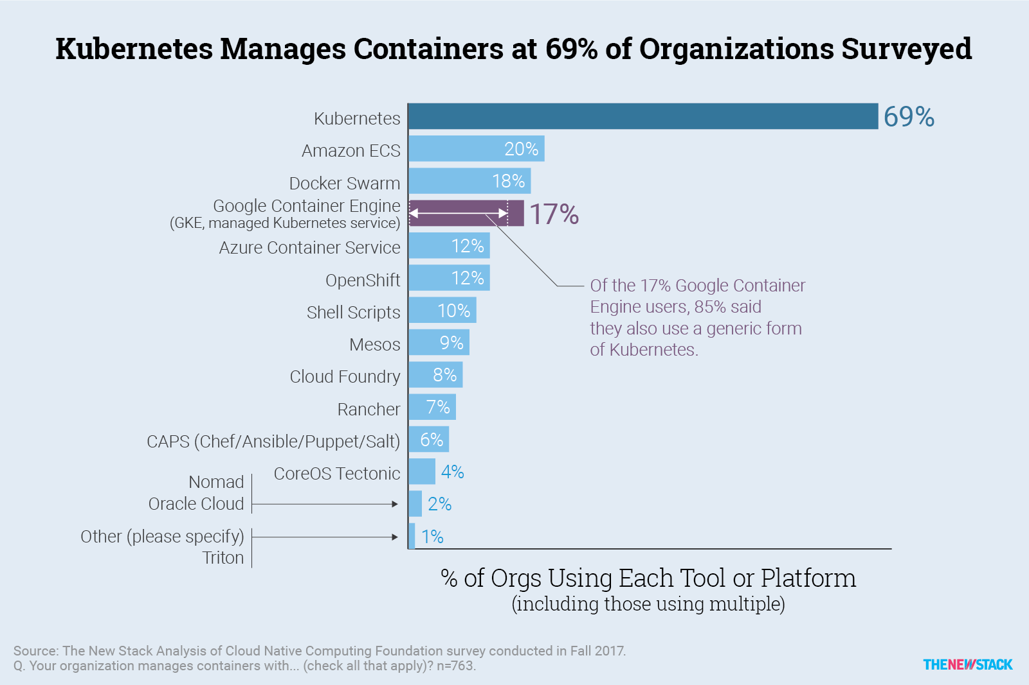
WhY Kubernetes?

Slide 9
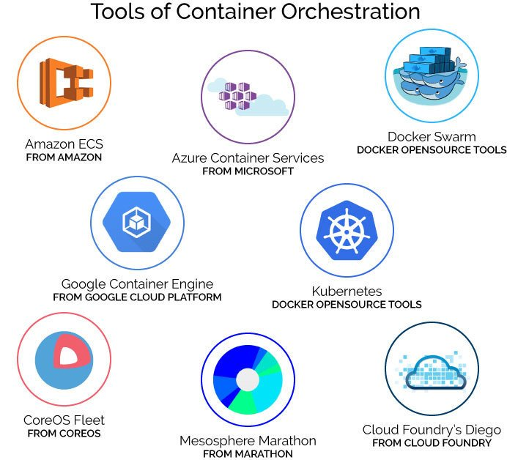
Different Container Orchestration Tool

Slide 10
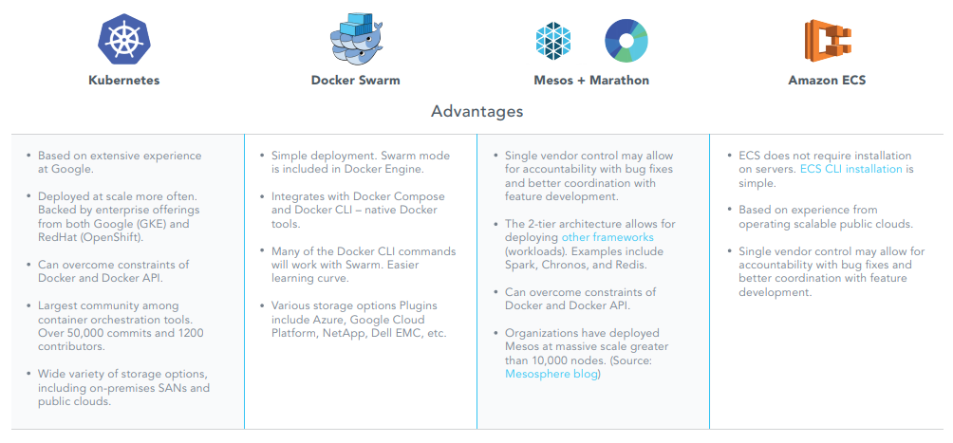
Comparison (k8s – Swarm – Mesos – ECS): Advantages

Slide 11
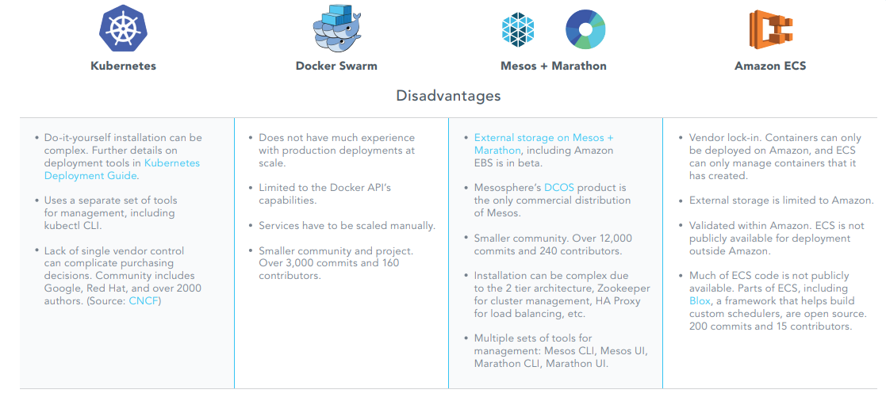
Comparison (k8s – Swarm – Mesos – ECS): DISAdvantages

Slide 12
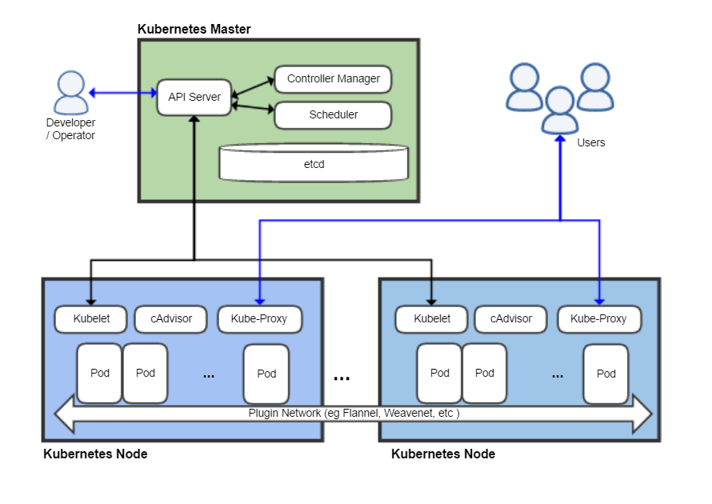
Kubernetes Components - Master
Kubernetes control plane (master)
The Kubernetes Master is the main controlling unit of the cluster, managing its workload and directing communication across the system.
etcd
It’s a persistent, lightweight, distributed, key-value data store developed by CoreOS that reliably stores the configuration data of the cluster, representing the overall state of the cluster at any given point of time.
API server
The API server is a key component and serves the Kubernetes API using JSON over HTTP, which provides both the internal and external interface to Kubernetes.
Components

Slide 13
Kubernetes Components - Master
Scheduler
The scheduler tracks resource use on each node to ensure that workload is not scheduled in excess of available resources, the scheduler's role is to match resource "supply" to workload "demand"
Controller manager
A controller is a reconciliation loop that drives actual cluster state toward the desired cluster state
Replication Controller, which handles replication and scaling by running a specified number of copies of a pod across the cluster.
DaemonSet Controller, for running exactly one pod on every machine (or some subset of machines), and a "Job Controller" for running pods that run to completion,

Slide 14
Kubernetes Components – Slave (Minion)
Kubelet
Kubelet is responsible for the running state of each node, ensuring that all containers on the node are healthy. It takes care of starting, stopping, and maintaining application containers organized into pods .
Pod
A container resides inside a pod. The container is the lowest level of a micro-service that holds the running application, libraries, and their dependencies.
Components

Slide 15
Kubernetes Components – Slave (Minion)
Kube-proxy
The Kube-proxy is an implementation of a network proxy and a load balancer. It is responsible for routing traffic to the appropriate container based on IP and port number of the incoming request.
cAdvisor
cAdvisor is an agent that monitors and gathers resource usage and performance metrics such as CPU, memory, file and network usage of containers on each node.
Components

Slide 16

Labs
Let’s Start

Slide 17
Onboarding & Account Creation
Goto https://www.katacoda.com/courses/kubernetes/playground
Create your account here.
Click on launch.sh

Slide 18
Common :
Task 1: Download Files
Task 2(O): How to Create & Save file
Download files from github:
git clone https://github.com/VaibhavG10/k8s-labs-yaml
cd k8s-labs-yaml/
Open Playground
vi file.yml
Press “i” for edit mode
Paste copied data
Press “esc”
Write “:wq” to save & exit

Slide 19
Lab1: HelloWorld with POD, Replicaset & Deployment
Learn how to deploy a single pod. Create pod using replicaset & deployment. Play around deployment.
Deploy helloworld POD
Deploy helloworld Replicaset
Play with deployment

Slide 20
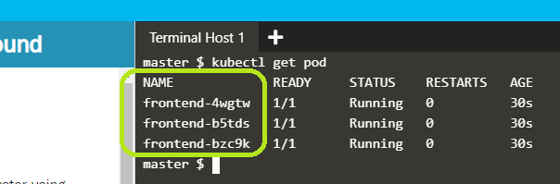
Lab1:
Task 1: Pod
Task 2: Replica Set
kubectl create -f pod-helloworld.yml
kubectl get pod
kubectl logs myapp-pod
kubectl delete po myapp-pod
kubectl get pod
kubectl create -f replicaset-helloworld.yml
kubectl get pod
kubectl delete po <Name of POD>
kubectl get pod
kubectl get rs
kubectl delete rs frontend
kubectl get rs

Slide 21
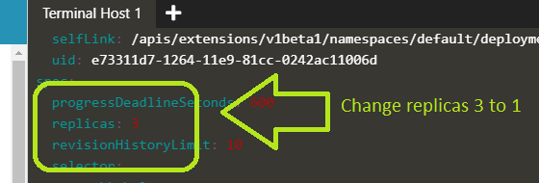
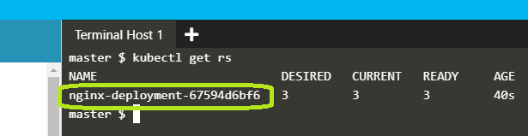
Lab1:
Task 3: Deployment
Task 4: Modify Deployment
kubectl create –f deployment-helloworld.yml
kubectl get pod
kubectl get deployment
kubectl get rs
kubectl delete rs <NameOf Replica set>
kubectl get rs
kubectl get deployment
kubectl edit deployment nginx-deployment
kubectl get pod
kubectl delete deployment nginx-deployment

Slide 22
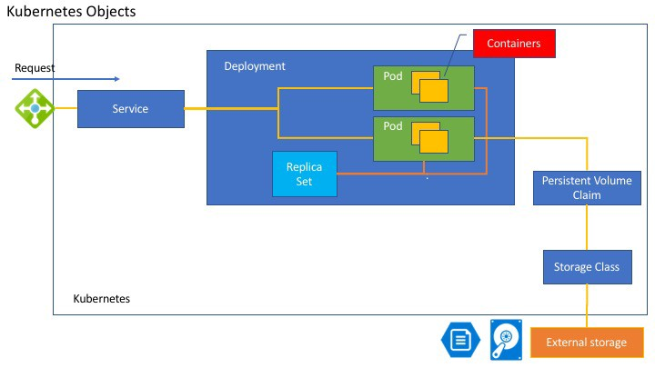
Overview

Slide 23
Lab2: Daemonset & Namespace
DaemonSet ensures that all eligible nodes run a copy of a Pod
Namespaces are intended for use in environments with many users spread across multiple teams
Create Daemonset
Create custom namespace
Deploy pod in custom namespace

Slide 24
Lab2:
Task 1: Daemonset
Task 2: Namespace
kubectl create -f daemonset-helloworld.yml
kubectl get po
kubectl get po -n kube-system
kubectl get po -n kube-system -o wide | grep fluentd
kubectl create namespace test
kubectl get namespaces
kubectl create -f pod-helloworld.yml -n test
kubectl get pod -n test

Slide 25
Lab3: Service & Nodeport with labels & selector
Service can be defined as an abstraction on the top of the pod which provides a single IP address and DNS name by which pods can be accessed.
Type Of Service
ClusterIP
Node Port
Load Balancer
External Name
Create k8s service object
Demo with Nodeport Type service

Slide 26
Lab3:
Task 1: Service
Task 2: NodePort
kubectl create -f deployment-nginx-helloworld.yml
kubectl create –f svc-nginx-helloworld.yml
kubectl get svc
curl <cluster-IP>:3000
kubectl get pod –o wide
kubectl get nodes –o wide
curl <node-ip>:30303

Slide 27
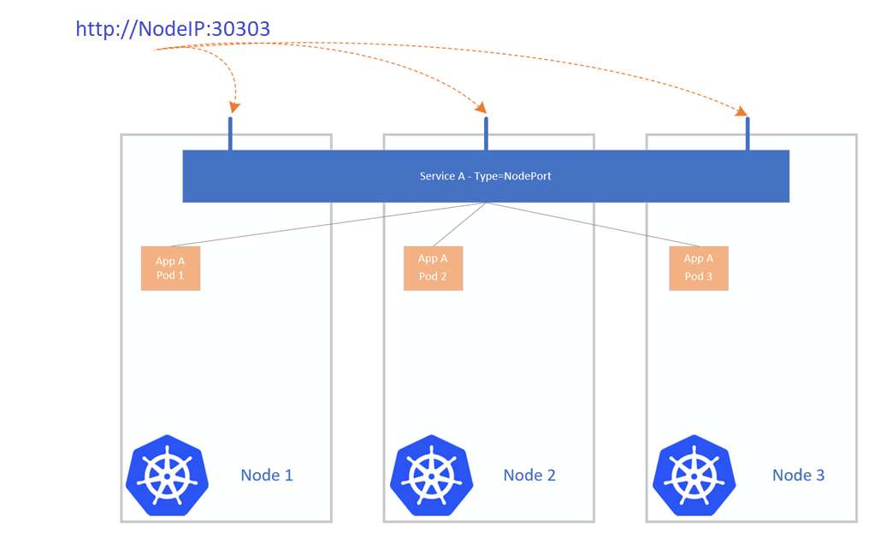
Node Port

Slide 28
Lab4: Work with Commands
Learn different K8s commands for practice
Learn different cleanup & useful commands
List out different get, describe, edit & other commands

Slide 29
Lab4:
Task 1: Useful Commands
Task 2: Cleanup Commands
kubectl cluster-info
Kubectl describe pod <name of pod>
kubectl get nodes –o wide
Kubectl get namespaces
kubectl get pods --show-labels
kubectl get pods –o wide
kubectl get pods --all-namespaces
kubectl get deployment –o yaml
kubectl delete namespace <name of namespace>
kubectl delete pod <name of pod>
kubectl delete rs <name of rs>
kubectl delete deployment <name of deployment>
kubectl delete svc <name of svc>
kubectl delete secret <name of secret>

Slide 30

Q&A

Slide 31
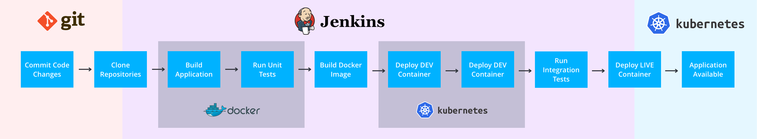
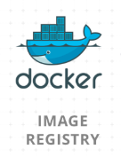
Overview where k8s fit

Slide 32

What NEXT ?

Slide 33
Summary
Summary:
About Container Orchestration
Kubernetes
Why Kubernetes?
Different Container Orchestration Tool
Comparison (k8s – Swarm – Mesos – ECS)
Kubernetes Components – Master
Kubernetes Components - Slave
Useful Url’s:
https://kubernetes.io/docs/tutorials/kubernetes-basics/
https://kubernetes.io/docs/concepts/overview/what-is-kubernetes/
https://github.com/kubernetes
https://www.cncf.io/
https://youtu.be/90kZRyPcRZw
https://blogs.msdn.microsoft.com/arsen/2018/05/17/certified-kubernetes-administrator-cka-cncf-exam-preparation-resources-that-i-found-useful/
What’s Next:
Install k8s cluster on your workstation
Practice with real time scenario’s
Explorer secrets, scaling, networking & other k8s feature
Explorer different use cases of k8s
Clear CKA/CKAD Exam

Slide 34
Find & Learn More About K8s
Service Discovery
Ingress controller
External DNS
Resource Quotas
Secrets
Annotation
ConfigMaps
RBAC
Health Check
Logging & Monitoring in kubernetes
Helm

Slide 35
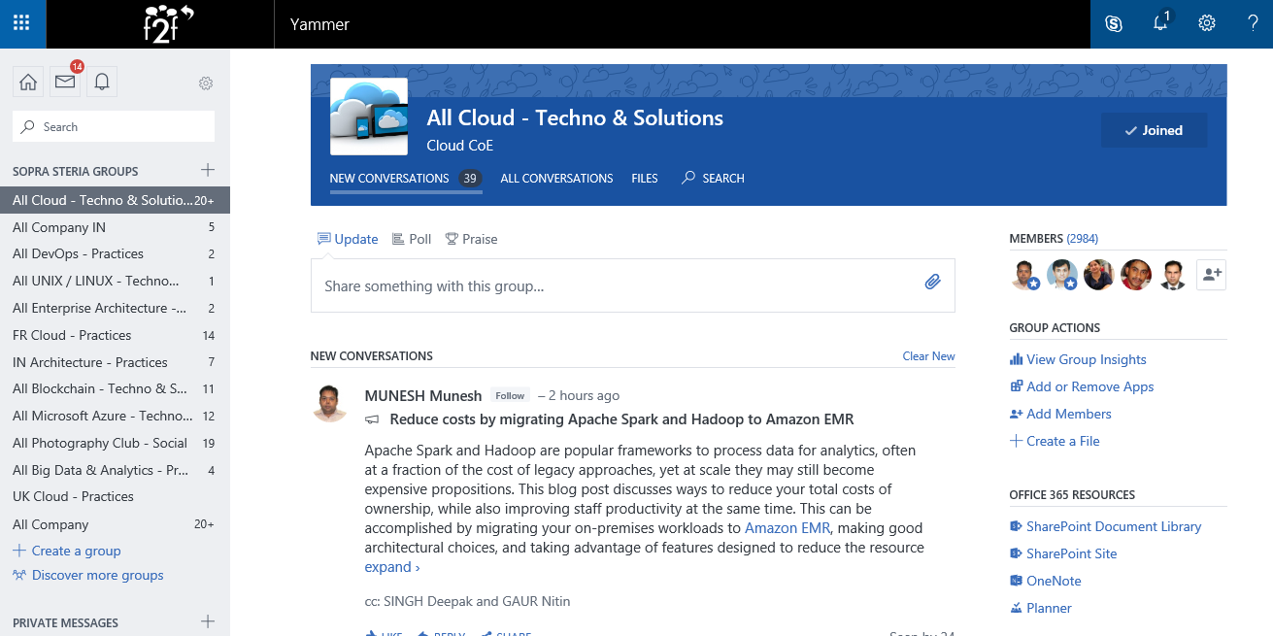
Cloud COE on Yammer

Slide 36
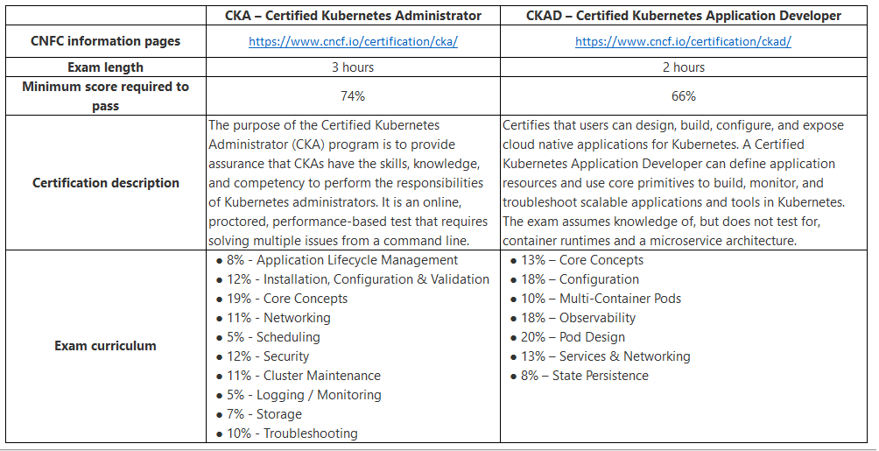
K8s Certification

Slide 37

Thanks

